Slide 1
A 13th Magnitude Asteroid Occultation Close to the Full Moon
By Paul D. Maley, Carefree, AZ and Tony George, Scottsdale, AZ
International Occultation Timing Association (IOTA)
Presented at the IOTA Annual Conference July, 2016

Slide 2
INITIAL CONDITIONS
13.2 MAG STAR
12.7 MAG ASTEROID BOLIVIANA
Δm=0.5
Duration = 9.7 seconds
Moon phase 100%
Moon offset 3 deg
Elevation 30 deg directly over Phoenix light bubble
SKY=CLEAR

Slide 4
WHAT TO DO WITH AN EVENT LIKE THIS?
REJECT IT AS IMPOSSIBLE?
TRY IT OUT OF DESPERATION?
USE IT AS A TEST OF SYSTEM CAPABILITIES?

Slide 5
C11 AND OBSERVATION SITE

Slide 6
PREPOINT SET UP 1.5 PRIOR

Slide 7
MY VIEW OF ZR80 CAMCORDER SCREEN 14 minutes AFTER CLOSEST APPROACH TO THE MOON OF STAR

Slide 9
DETECTION FOR ANALYSIS
FOR THIS CASE, CLOCK DRIVE WAS ON
LIMOVIE CAN PROCESS WITH DRIVE ON OR OFF
30 SECONDS OF VIDEO IS THE MINIMUM NEEDED TO DETECT BASELINE NOISE
MORE VIDEO IS BETTER

Slide 10
REGISTAX STACKED IMAGES
STARS
DEAD PIXELS
DUST MOTES

Slide 11
GUIDE CHARTS: WHAT I FAILED TO SPOT
PREDICTED EVENT TIME

Slide 12
C2A ACTUAL FIELD OF VIEW OF FINAL IMAGE

Slide 13
HOW FAR OFF THE PLANNED FIELD: ~90 SECONDS

Slide 14
PHOTOMETRY
10.3 MAG STAR
12.3 MAG STAR
BLANK FIELD:
NO STAR

Slide 15
Occular detectability of a 12.2 magnitude star with a Δm=2.0

Slide 16
Occular detectability of a 10.388 magnitude star with a Δm=0.5

Slide 17
Minimum Occular dectability of a 10.388 magnitude star with Δm=0.5

Slide 18
PALLAS OCCULTATION 7/7/16 dM of 0.08

Slide 19
PALLAS OCCULTATION 7/7/16

Slide 20
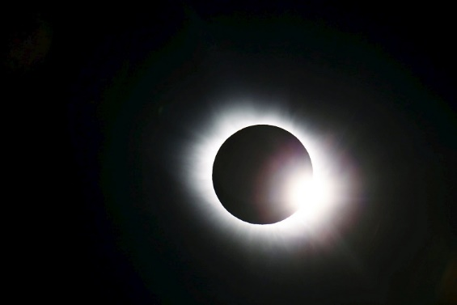
TONY GEORGE PROCESSING IS LIKE THIS:

Slide 21
CONCLUSIONS
SOME IMPOSSIBLE THINGS ARE POSSIBLE (WITH CURRENT TOOLS)
SOME THINGS ARE NOT
EVEN THOUGH OCCULTATION FAILED, GOOD THINGS WERE LEARNED
WITH EQUIPMENT AND CONDITIONS DEFINED ABOVE:
DETECTING A 13.2 MAG STAR WITHIN 3 DEG OF 100% MOON IS NOT POSSIBLE
DETECTING A 10 MAG STAR WITH Δm=0.5, DURATION>3 SEC IS POSSIBLE
DETECTING A 12.2 MAG STAR WITH Δm=2.5, DURATION>10 SEC IS POSSIBLE

